Slide 1
goFIT: Concept Video
Brought to you by Team FITLIT

Slide 2
Team FITLIT
Christina Ramsey
Olivia Gregory
Bryce Tham
Denis Russu
Notes:
Team FITLIT + intros
RECAP:
Over the past few weeks, we’ve been conducting our needfinding interviews, constructing POV’s and HMW’s, and developing and testing experience prototypes that address the needs that we see in health, specifically in fitness and exercise.
When we left off last week, we had decided that we were trying to address the needs of those who wanted to live healthy lifestyles but currently weren’t, either because they didn’t have time to fit it into their days, weren’t excited about the idea of exercising, or found it hard to motivate themselves because they preferred social activities.
That led to the ideas that I will be presenting: specifically in our value proposition and problem and solution overview, but also in the tasks that we highlighted and the video that we ended up storyboarding.

Slide 3
Value Proposition
What will customers get from our product?
Notes:
From this we developed our value proposition, which is what we hope customers will get from our product. We wanted it to be as short and simple as possible, and really just focus on our core message.

Slide 4
Inspiration to maintain a
healthy lifestyle.
Notes:
Which was that our product will be “Inspiration to maintain a healthy lifestyle.”

Slide 5
Problem/Solution Overview
What problem are we going to solve?
Notes:
And that proposition really developed in response to the problems that we wanted to solve and the way we wanted to go about solving them, which we describe in our problem/solution overview.

Slide 6
Problem Overview
Although many people want to stay healthy, they rarely prioritize their health, saying they don’t have time, don’t want to wait for the long-term benefits, or prefer to do other, more social, activities.
Notes:
We saw the main problem that we wanted to solve as this:
Although many people want to stay healthy, they rarely prioritize their health, saying they don’t have time, don’t want to wait for the long-term benefits, or prefer to do other, more social, activities.

Slide 7
Solution Overview
We want a product that offers meaningful social connection and immediate rewards when users meet fitness and nutrition goals.
This should motivate people to be more excited about maintaining a healthy lifestyle, demonstrating that the act itself - not the incentives - is worth prioritizing.
Notes:
In response, we developed the following solution:
We want a product that offers meaningful social connection and immediate rewards when users meet fitness and nutrition goals.
This should motivate people to be more excited about maintaining a healthy lifestyle, demonstrating that the act itself - not the incentives - is worth prioritizing.

Slide 8
Tasks
What are the core values our project enables?
Notes:
And that led us to develop new and existing tasks that we thought our product should enable. We wanted to focus on how our product would contribute to user behavior - not focus on specific features that we could implement.

Slide 9
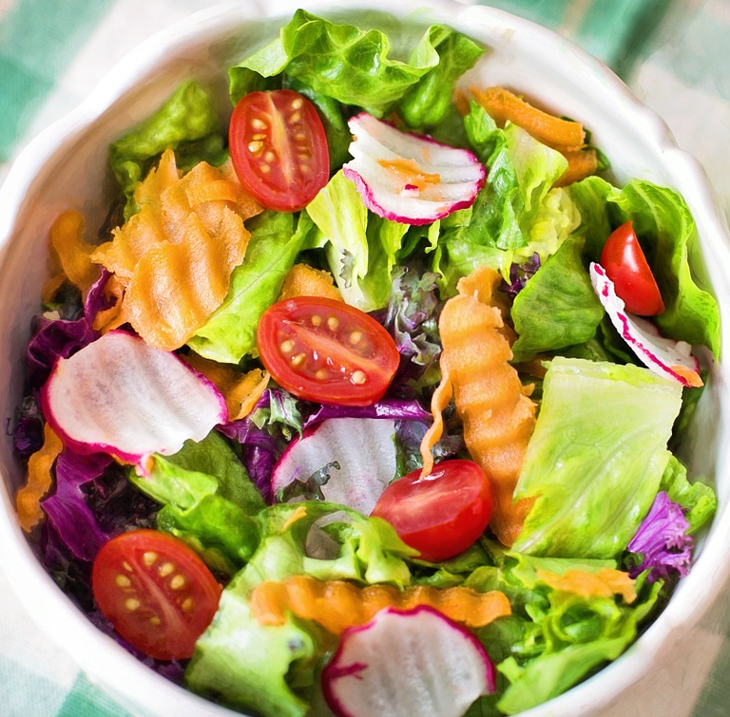
1. Promote Healthy Eating (Simple)
People know health benefits already
Convenience vs. effort
Encouragement, direction, and small steps go a long way
Notes:
The first that we came up with was that we wanted to promote healthier eating.
We know that, when left alone, people will choose to eat junk food, despite knowing that it isn’t good for them, even though they often have healthier alternatives.
To them, the convenience of junk food outweighs the benefits of healthy food.
We labelled this task as simple because it would be simple for us and the user: people already know the benefits of eating healthy, and it would be up to us to provide encouragement and direction in terms of bettering someone’s nutrition.
But it would also be simple for people to better their health by improving their diet just a little - cutting out an unhealthy bag of chips or a soft drink per day would go a long way in making someone healthier.
https://pixabay.com/p-791891/?no_redirectfi

Slide 10

2. Demonstrate maintaining a healthy lifestyle (simple)
People assume that this takes effort and commitment
One can do simple things to stay healthy
This will have a significant impact long term
Notes:
The second task we came up with is similar. We wanted to demonstrate maintaining a healthy lifestyle, both as inspiration to other people but also proof that it is possible to do without making drastic changes to your lifestyle.
Many people shy away from being healthy because they think that it requires a lot of effort and commitment (Spartan runs, going regularly to gym, only eating healthy food).
However, there are simpler things you can do to stay healthy (taking the stairs, drinking more water, stretching/yoga when you have time) that will have a long term impact but don’t really disrupt your daily life.
We labelled this task simple as well: it would be easy enough for us to show people the small changes that they can make that will end up having a significant impact, and we think that it will be simple enough for users to change their behavior to make small modifications in their day to day schedule.

Slide 11
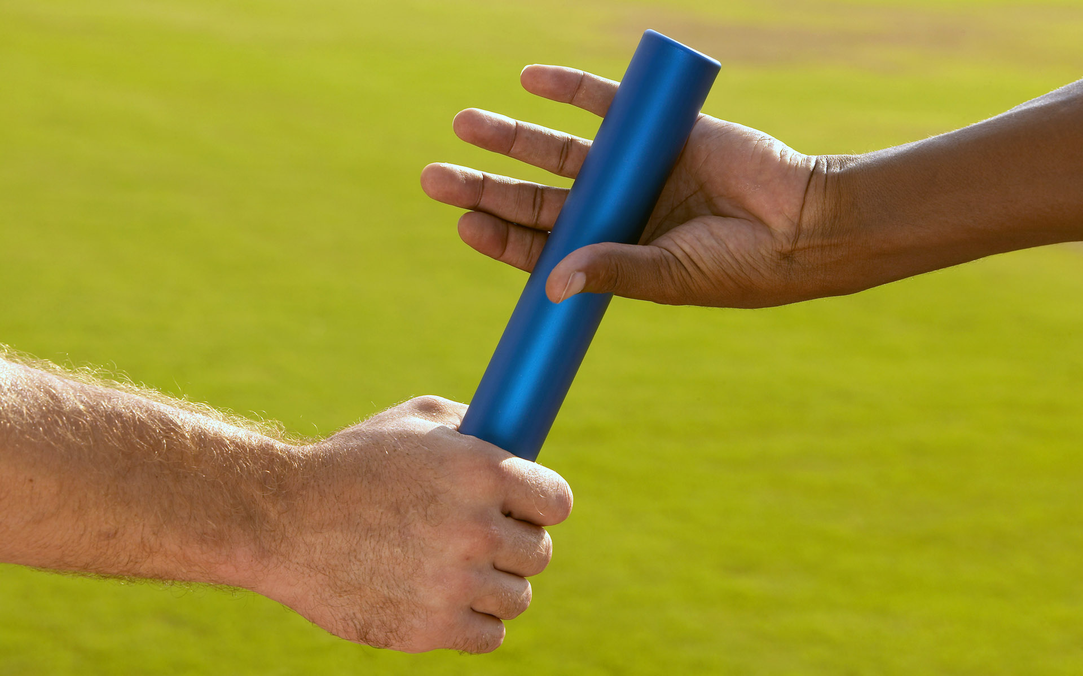
3. Inspire others to be healthy (medium)
Positive vs negative pressure
Challenging your friends
Set goals together
Notes:
The third task that we wanted to enable was that of inspiring others to be healthy.
A lot of the problem with fitness apps, or even going to the gym, is that a lot of people feel the need to be as impressive as possible. Some of the people we interviewed told us that they wanted to be in shape before they go to the gym; one of the people who tested our experience prototypes said the idea of people seeing her stats (and maybe seeing if she’s slacking off) would definitely motivate her to exercise.
So we found that pressure to be healthy can be positive or negative.
We labelled this task as medium because it will be a little harder for us. We do think that positive pressure - which includes challenging your friends and setting goals together - can be a very helpful way to lead others to be healthy, but we don’t want to cross the line and motivate people to exercise by conveying that they’ll look bad if they don’t. It will also be a little harder for the user; it requires a little more action and initiative on their part, because now we’re trying to get them to be healthy for their sake and to help others.
https://upload.wikimedia.org/wikipedia/commons/d/df/BXP135677.jpg

Slide 12
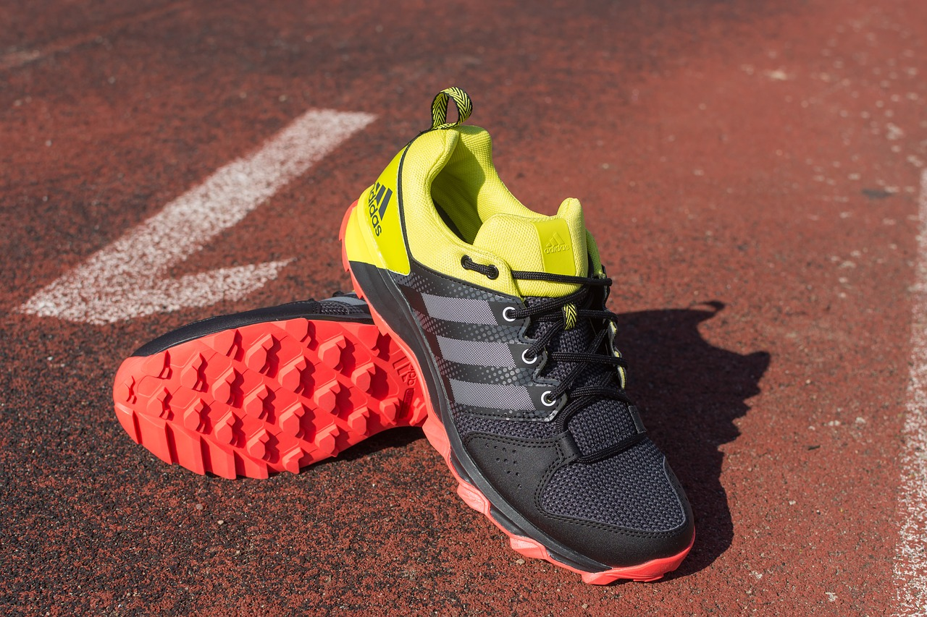
4. Motivate users to prioritize fitness (complex)
Prioritizing fitness isn’t easy
Motivation shouldn’t come from incentives to win rewards
Creating a healthy life is a worthy goal in and of itself
Notes:
The last task that we came up is the one that we think will be the hardest, because it involves changing how people think. For this task, we want to motivate users to prioritize fitness.
This is challenging for several reasons: it’s hard enough to prioritize exercise, and it gets even harder once you come up with an excuse - any excuse - like convincing yourself that you’re too busy or have other things to do.
However, motivating yourself - especially to maintain a better lifestyle - is an important step in helping yourself stay healthy.
The will to stay healthy should eventually be a goal in and of itself - people shouldn’t only exercise or eat healthy if they think they’ll earn some kind of badge or trophy from it.
That’s why we labelled this as complex. We as the product want to change how people think and how they prioritize health and fitness, which is a lot more difficult than just finding time for them in their schedule to work out or giving them badges every time they complete a goal. It’s also the most challenging of our tasks for the user, who ideally would wind up understanding that being healthy is important and in and of itself is a goal worth working towards.
https://pixabay.com/p-2309279/?no_redirect

Slide 13
Storyboarding
How do we convey these ideas clearly?
Notes:
When we started storyboarding to explain our concept and the context of our product, we wanted to focus on the last of the three tasks
Demonstrate maintaining a healthy lifestyle
Inspire others to be healthy
Motivate users to prioritize their fitness

Slide 14
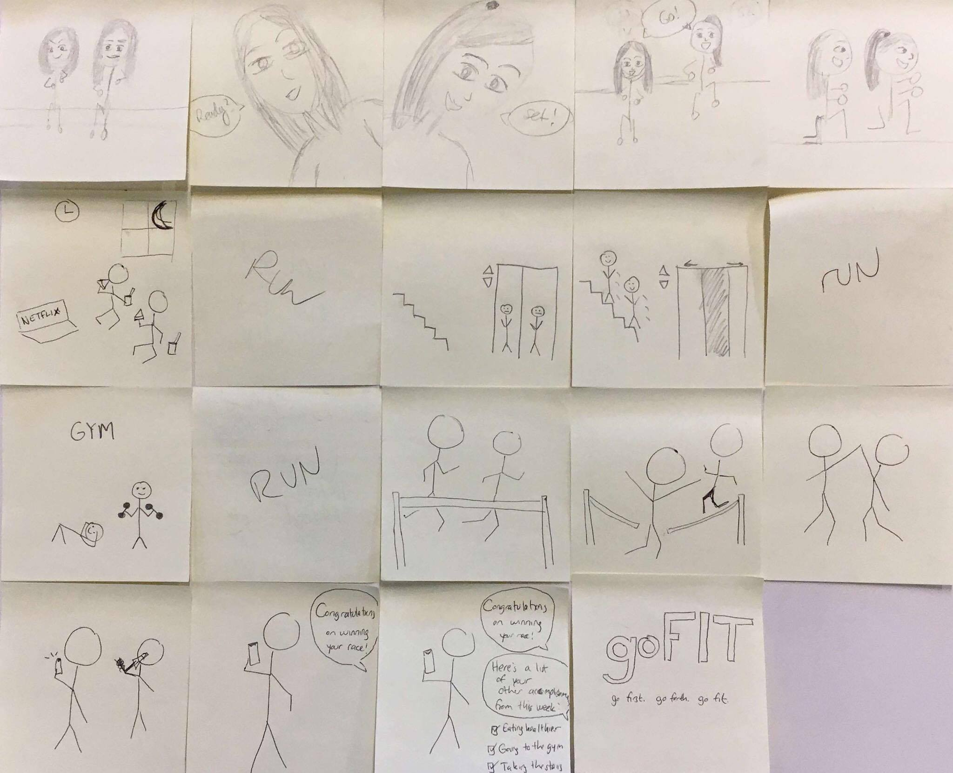
Notes:
The completed storyboard is shown here.
In several scenes we really tried to demonstrate the tasks our product enables and the benefits of our concept
Some scenes just add continuity to the overall storyline
Some final ones that introduce the product.

Slide 15
Scene 1: Starting the Race
Inspire others to be healthy
Motivate users to prioritize fitness
Set up the scene and characters
Profile and front view
Notes:
The first scene I want to talk about is the first scene of the video. It was important for us because it showed two of our tasks that we thought would be difficult to show visually.
We tried showing inspiring others to be healthy by setting up a friendly competition;
We wanted to show motivating users to prioritize fitness by showcasing two people who (you learn over the course of the video) really worked up to this moment - they didn’t start here as active and healthy and happy and fit individuals.
Some notes from the scene:
As our introduction, we really wanted this to set up the scene and the story and introduce the characters. We wanted a variety of shots and camera angles and just add movement to this scene, where the actors were standing still for most of it.

Slide 16
Scene 2: Show the “Before”
Don’t show the tasks: show how you can benefit from them
Overall - show that these people are unhappy
Netflix, junk food, bad posture
Notes:
The next scene is probably the shortest of the video. It wasn’t meant to showcase a task - shows how you can benefit from the tasks
Wanted to show an unhealthy lifestyle - the “before.”
Before the motivation, before the fitness, before the healthy food, the exercise, the inspiration, etc
Storyboarding notes:
Clearly show netflix, junk food, bad posture
Show that the characters are unhealthy. They aren’t taking care of themselves and they’re unhappy

Slide 17
Scene 3: Elevator “Turning Point”
Demonstrate maintaining a healthy lifestyle
Simple changes can make a difference
Focus on the decision: decide at the last minute to take the stairs
Notes:
The third scene we storyboarded marked the turning point - transition from the unhealthy, unhappy lifestyle to one in which the characters begin to actively change how they’re living.
The task that we wanted to demonstrate was that of showing how to maintain a healthy lifestyle
Doesn’t have to be a monumental change - even simple things, like taking the elevator instead of the stairs, can help (and can help spark change)
Storyboarding notes:
One camera angle, one shot: focus on the characters and their decision (which should be the main driving change of this scene), so keep the filmwork as simple and constant as possible

Slide 18
Scene 4: Achieving the goals
Inspire others to be healthy
Everyone’s celebrating
Notes:
This scene is the second to last one we storyboarded, and the last one I’ll talk about.
The task it showed was that of inspiring others to be healthy
Sure, one person has to finish the race first, but that doesn’t mean that they aren’t both winners - they clearly both benefit, they both are thrilled, they both are celebrating.

Slide 19
Concept Video
What is the context of our product in the real world?
Notes:
We tried to demonstrate our tasks and follow our storyboard as closely as possible.

Slide 20
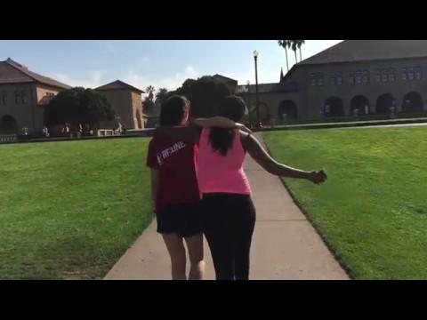

Slide 21
Questions?

Slide 22
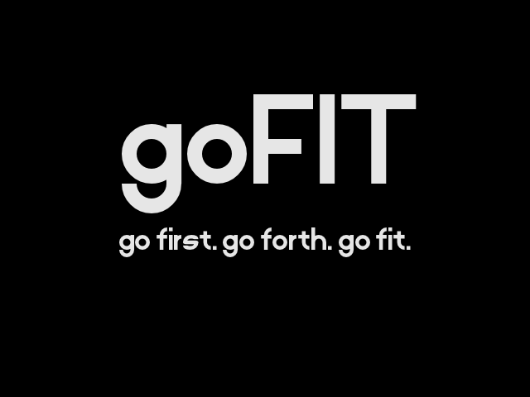

Slide 23
Concept Video Link:
https://www.youtube.com/watch?v=0D0wkahfV74&feature=youtu.be

Slide 24
Credits
Special thanks to all the people who made and released these awesome resources for free:
Presentation template by SlidesCarnival
Photographs by
Unsplash
https://pixabay.com/p-791891/?no_redirectfi
https://upload.wikimedia.org/wikipedia/commons/d/df/BXP135677.jpg
https://pixabay.com/p-2309279/?no_redirect

